Slide 1





ICAMADA 2024
GeoLens - Enhanced Geo Dataset Orchestration Library for Pythonic Implementation
Authors: Janavi Nathwani, Samvram Sahu, Jayasri PV, Usha sundari HSV Rayali,
Yerragudipadu Subbarayudu
Presented By: Janavi Nathwani
B.Tech 4th year,
- Department of Computer Science Engineering - Ai&Ml
- KG Reddy College of Engineering and Technology

Slide 2
ICAMADA 2024
Presentation at a Glance
Abstract
Introduction
Problem statement
Methodology / architecture
Result and discussion
Conclusion
Reference

Slide 3
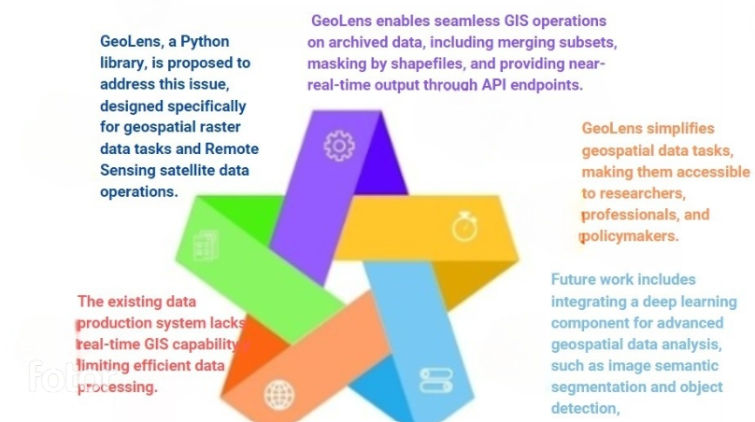
ICAMADA 2024
Abstract
3
2
4
1
5

Slide 4
ICAMADA 2024
Introduction
Advancements in satellite technology, remote sensing, and GIS have led to the collection of vast amounts of geospatial data, including satellite imagery and SAR data, with unprecedented detail and frequency.
Potential Applications: This wealth of data holds immense potential for applications in agriculture, forestry, urban planning, disaster management, and environmental monitoring.
Challenges: Accessing and analyzing satellite geospatial data is hindered by complex tools and high costs associated with specialized software. Challenges include the preprocessing of raw data and the cost of acquiring and maintaining specialized software licenses.
Need for Solutions: There is a need for cost-effective and user-friendly tools that simplify the access and analysis of satellite geospatial data. Developing such tools can enhance the usability of satellite data and unlock its full potential for a wide range of applications.

Slide 5
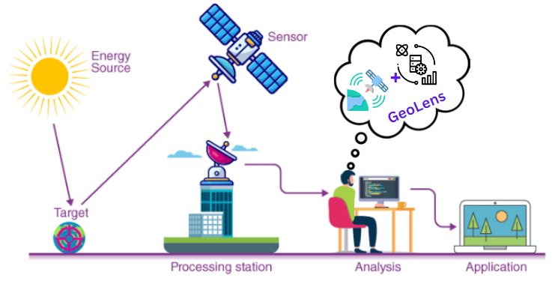
ICAMADA 2024
Problem Statement
The processing of large geospatial datasets, often several gigabytes in size, poses significant challenges in terms of efficiency and time consumption.
ISRO's Codelab aims to address this challenge by developing a GeoLens, a framework that enables on-the-fly modification of data products. GeoLens allows for the efficient processing and delivery of modified data products to clients, thereby enhancing the overall processing workflow of large dataset.

Slide 6
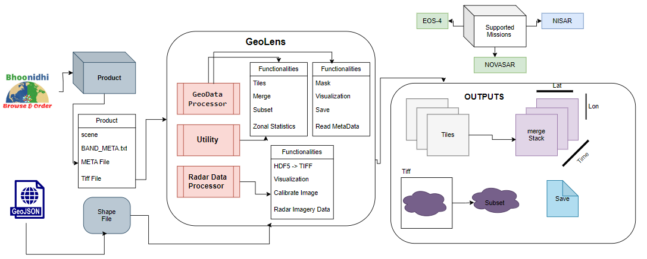
ICAMADA 2024
Methodology

Slide 7
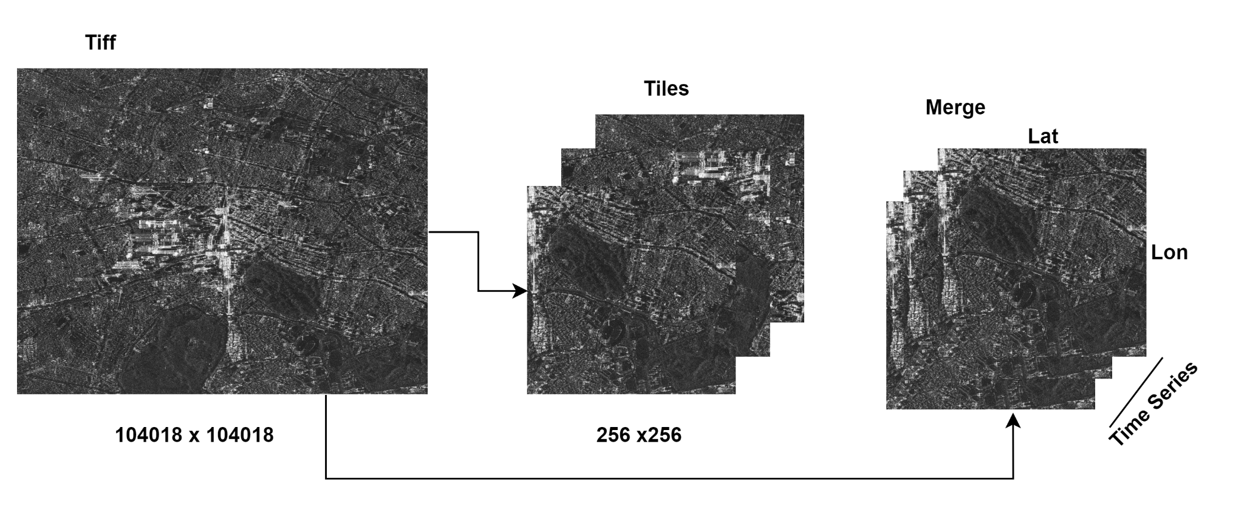
Results and Discussion
ICAMADA 2024
RasterTileDivider expertly partitions expansive raster images into smaller, designated tiles, saving them as individual TIFF files while handling edge cases for thorough processing.
Merging integrates multiple input TIFF files by stacking them, a crucial step for generating time series data that meets the growing demand for Analysis-Ready Data (ARD) applications.

Slide 8
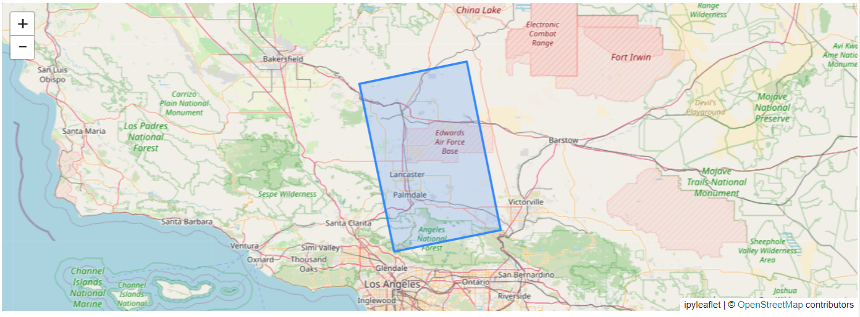
ICAMADA 2024
Visualization
This function uses the ipyleaflet library for creating interactive maps and the h5py library for reading HDF5 files.
The input is an HDF5 file containing SAR satellite data.
The function reads the bounding polygon from the file, calculates the scene center, creates an interactive map centered on the scene, and adds a layer displaying the bounding polygon. Finally, it displays the map.

Slide 9
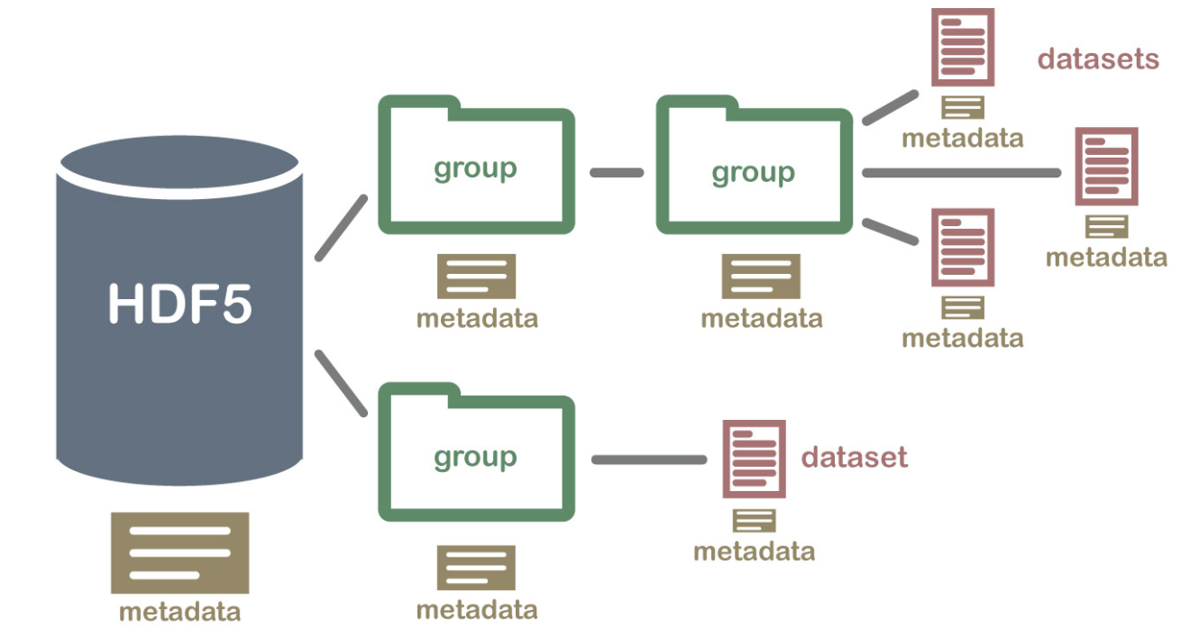
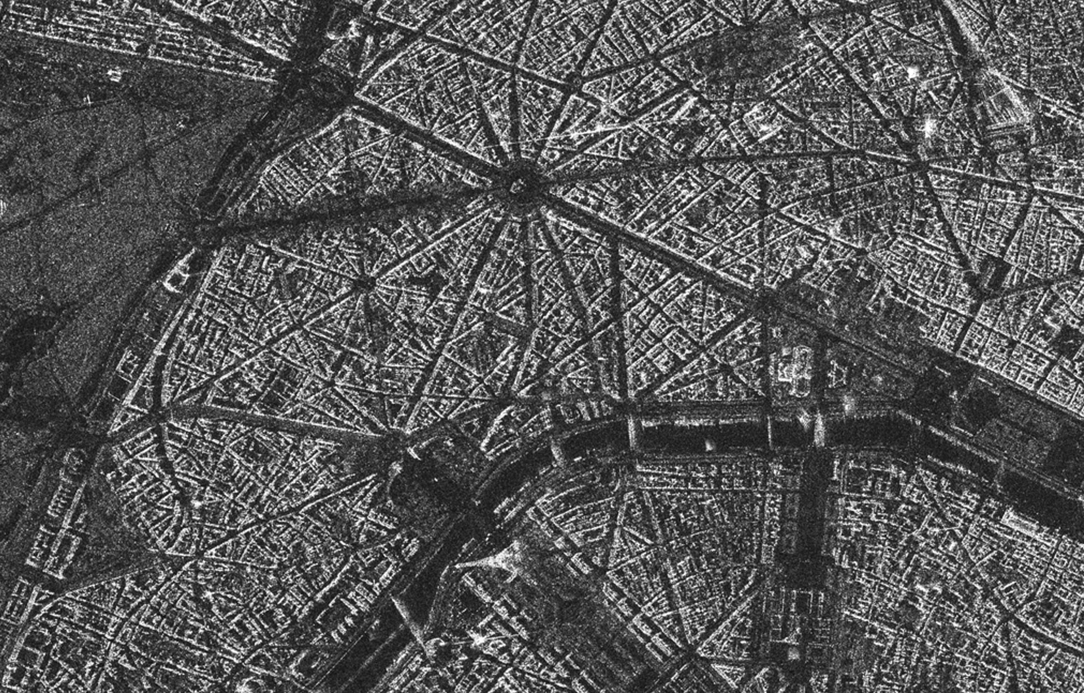
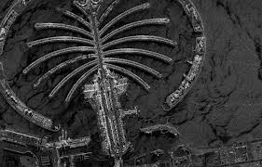
ICAMADA 2024
HDF5 to Tiffs Conversion
This function iterates over a hierarchical HDF5 file structure, extracts information based on predefined folders and keys, and generates a list of file paths for specific TIFF files based on the extracted information.
It uses the h5py library to interact with the HDF5 file and navigate its structure.

Slide 10
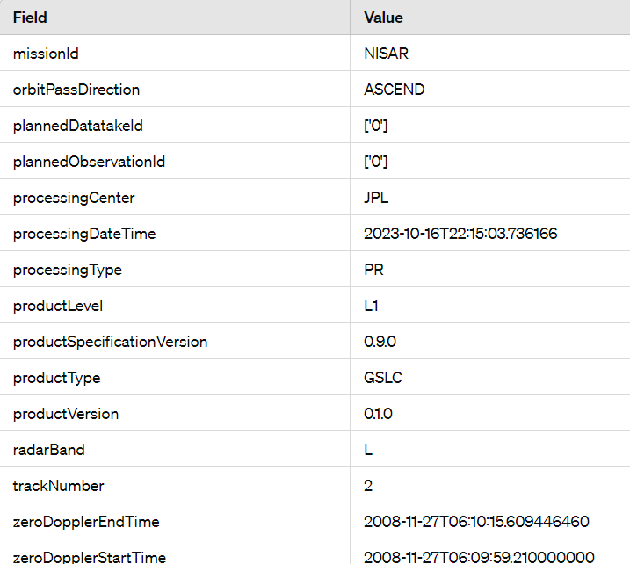
ICAMADA 2024
SAR Data Identity Extractor
The extracted data includes orbit number, bounding polygon, and processing details, presented as a dictionary.
This process is crucial for obtaining metadata essential for processing and comprehending SAR satellite data.

Slide 11
ICAMADA 2024
Conclusion
Problem Addressed: GeoLens addresses the limitations of the existing data production system by enabling real-time GIS operations on archived data.
Key Features: GeoLens offers a wide range of features, including metadata reading, subset creation, merging, masking by shapefiles, tiling, and data saving.
User Accessibility: By simplifying geospatial data tasks, GeoLens makes them accessible to researchers, professionals, and policymakers.
Impact: GeoLens has the potential to revolutionize geospatial data processing and analysis, offering a cost-effective and user-friendly solution for a wide range of users.
THANK YOU

Slide 12
ICAMADA 2024
References
[1] D. Solarna, L. Maggiolo, G. Moser and S. B. Serpico, "A Tiling-Based Strategy for Large-Scale Multisensor Optical-Sar Image Registration," IGARSS 2022 - 2022 IEEE International Geoscience and Remote Sensing Symposium, Kuala Lumpur, Malaysia, 2022, pp. 127-130, doi: 10.1109/IGARSS46834.2022.9884048
[2] L. Diaz, C. Martin, M. Gould, C. Granell and M. A. Manso, "Semi-automatic metadata extraction from imagery and cartographic data," 2007 IEEE International Geoscience and Remote Sensing Symposium, Barcelona, Spain, 2007, pp. 3051-3052, doi: 10.1109/IGARSS.2007.4423488.
[3] Norzin, A. F., & Daliman, S. (2022). Assessing Land Use and Land Cover Change Analysis Using Remote Sensing In Kota Bharu, Kelantan. IOP Conference Series: Earth and Environmental Science, 1102(1). https://doi.org/10.1088/1755-1315/1102/1/012079.
[4] Elhag, M., Gitas, I., Othman, A., Bahrawi, J., & Gikas, P. (2019). Assessment of water quality parameters using temporal remote sensing spectral reflectance in arid environments, Saudi Arabia. Water (Switzerland), 11(3). https://doi.org/10.3390/w11030556.
[5] Haag, S., Tarboton, D., Smith, M., & Shokoufandeh, A. (2020). Fast summarizing algorithm for polygonal statistics over a regular grid. Computers and Geosciences, 142. https://doi.org/10.1016/j.cageo.2020.104524.
[6] Namdar, M., Adamowski, J., Saadat, H., Sharifi, F., & Khiri, A. (2014). Land-use and land-cover classification in semi-arid regions using independent component analysis (ICA) and expert classification. International Journal of Remote Sensing, 35(24). https://doi.org/10.1080/01431161.2014.978035.
[7] Reina, G. A., Panchumarthy, R., Thakur, S. P., Bastidas, A., & Bakas, S. (2020). Systematic Evaluation of Image Tiling Adverse Effects on Deep Learning Semantic Segmentation. Frontiers in Neuroscience, 14. https://doi.org/10.3389/fnins.2020.00065.
[8] Sayar, A., Eken, S., & Mert, U. (2014). Tiling of Satellite Images to Capture an Island Object. Communications in Computer and Information Science, 459 CCIS. https://doi.org/10.1007/978-3-319-11071-419.
[9] Wojtaszek, M. V., Ronczyk, L., Mamatkulov, Z., & Reimov, M. (2021). Object-based approach for urban land cover mapping using high spatial resolution data. E3S Web of Conferences, 227. https://doi.org/10.1051/e3sconf/202122701001.

